Slide 1
Bios 7xx: Deep Learning Methods for Biomedical Applications with Pytorch
Chapter 1. Introduction to Deep Learning, PyTorch & Basic Algorithms
Notes:
It is my pleasure to be here presenting our research on dietary intake data. The goal of the study is to understand the association between cognition and temperament with nutrients and dietary patterns.

Slide 2
Content
1 Introduction to Deep Learning
2 Introduction to PyTorch
3 Introduction to UNC Research Computing Resources
4 Introduction to Basic Algorithm
Notes:
My presentation will include the following points.

Slide 3
Content
1 Introduction to Deep Learning
2 Introduction to PyTorch
3 Introduction to UNC Research Computing Resources
4 Introduction to Basic Algorithm
Notes:
My presentation will include the following points.

Slide 4
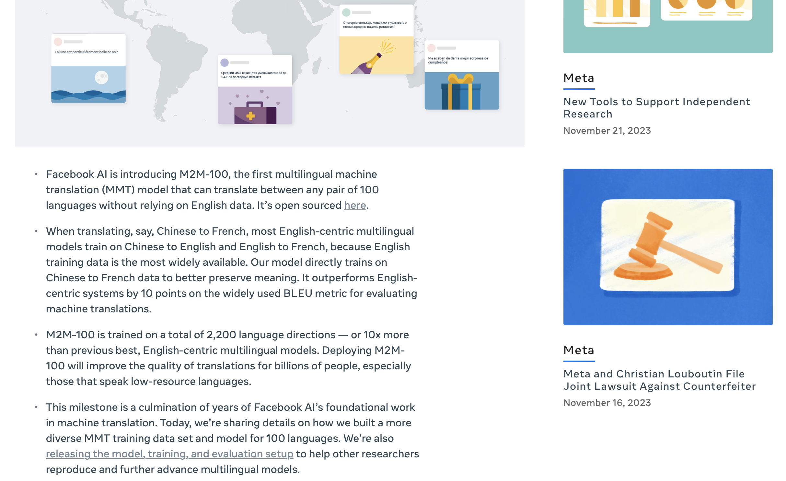
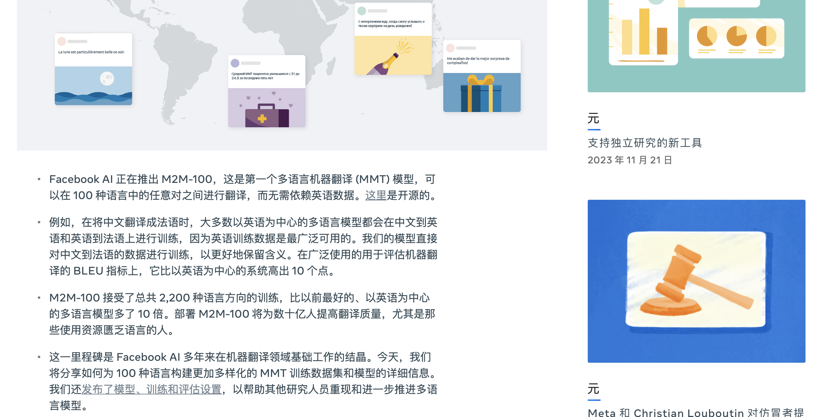
Deep Learning is Almost Everywhere Today
Language Translation in Natural Language Processing
Deep learning enhances real-time, accurate translation of languages, as seen in tools like Google Translate. The following picture shows the translation of a webpage from English to Chinese.

Slide 5
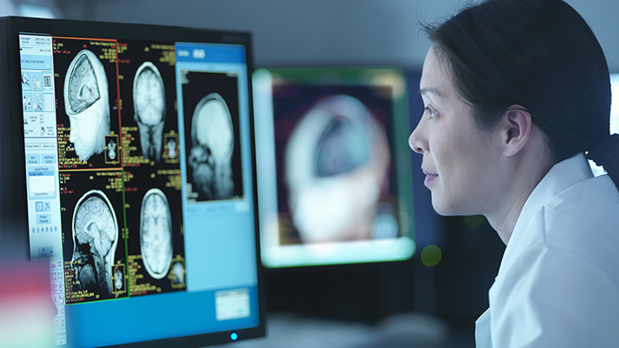
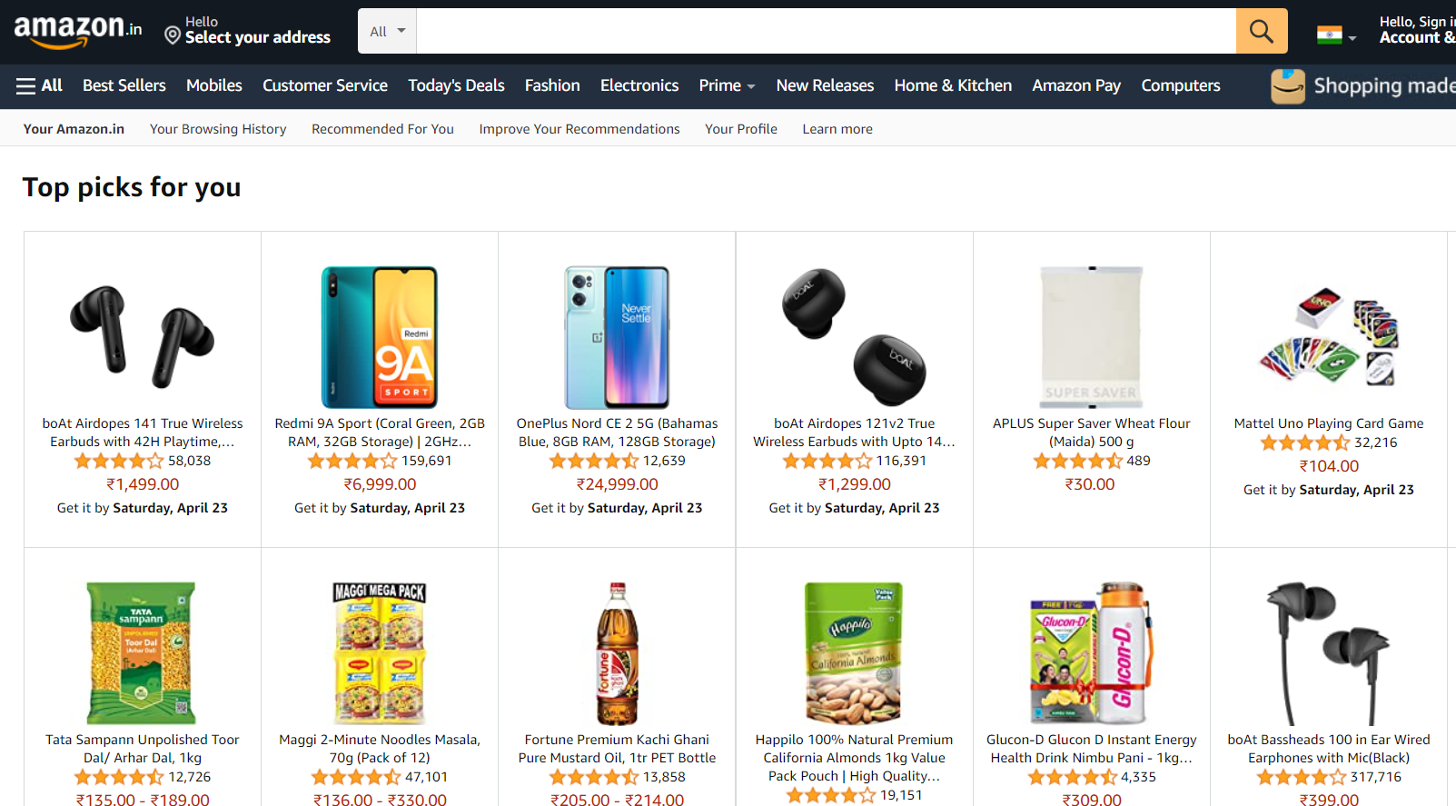
Deep Learning is Almost Everywhere Today
Personalized Shopping Experience in Retail and E-Commerce
Deep learning is leveraged to provide personalized recommendations and targeted advertising to customers based on their shopping behavior.
Disease Detection in Healthcare and Medicine
Deep learning can be utilized for early and more accurate detection of diseases like cancer, Alzheimer's, and heart diseases through image analysis.

Slide 6

What Exactly is Deep Learning?

Slide 7
Key Terminologies
Artificial Intelligence
Simulates human intelligence in machines for tasks like decision-making and language translation.
Machine Learning (ML)
A subset of AI where algorithms learn from data to make predictions or decisions without being explicitly programmed for each scenario.
Deep Learning (DL)
A branch of machine learning using multi-layered neural networks, effective in processing large amounts of unstructured data like images and speech.
Generative AI
AI algorithms that generate new, original content (like text or images) based on existing data, using techniques like Generative Adversarial Networks (GANs).

Slide 8
Deep Learning
Deep learning is a subset of machine learning that focuses on training artificial neural networks to perform tasks. Its algorithms were inspired by the working of the human brain.
It's characterized by the use of multiple layers (deep architectures) that allow networks to learn hierarchical representations of data and to learn to complete specific tasks.
In contrast to traditional machine learning, which often requires manual feature extraction, deep learning can automatically learn features from raw data, which you can think of as patterns that occur within the data.
Deep learning can be used for supervised, unsupervised as well as reinforcement machine learning.
Objective: teaching computer how to learn a task directly from raw data
Notes:
https://www.youtube.com/watch?v=QDX-1M5Nj7s&list=PLtBw6njQRU-rwp5__7C0oIVt26ZgjG9NI

Slide 9
Types of Deep Learning
Deep Learning
Unsupervised Learning
The neural network learns to discover the patterns or to cluster the dataset based on unlabeled datasets. There are no target variables.
Generative Model
DDPG
CNN
Autoencoders
Supervised Learning
An agent learns to make decisions in an environment to maximize a reward signal. The agent interacts with the environment by taking action and observing the resulting rewards.
Reinforcement Learning
RNN
Neural network learns to make predictions or classify data based on the labeled datasets.
Deep Q Network

Slide 10
Skill Sets
Math & Statistics
Computer Science
Probability, Linear algebra
Programming
Deep Learning
Domain Knowledge
Health science, medical

Slide 11
Class Schedule
Notes:
Change the specific schedule

Slide 12
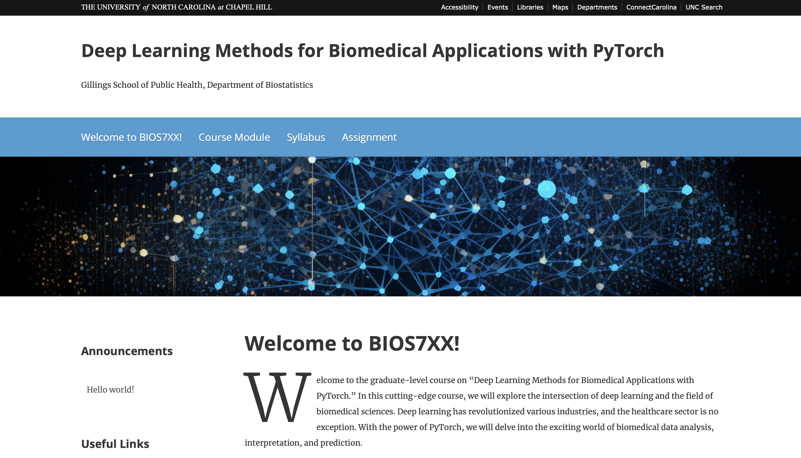
Course Website
https://tarheels.live/biosdlcourse/

Slide 13
Neural Networks
A neural network is a computational model inspired by the human brain's interconnected neurons.
It consists of layers: input layer, hidden layers, and output layer.
Neurons in each layer process information using activation functions.
Weights and biases are learned parameters that determine the strength of connections between neurons.
Notes:
Our original data is the dataset collected by our lab using 24h recall.
The data was collected in batch and there are some duplicated records in the first several batches.

Slide 14
Key Concepts
Activation functions introduce non-linearity, enabling neural networks to model complex relationships.
Forward propagation involves passing input data through the network to generate predictions.
Backward propagation calculates gradients to update weights and minimize the difference between predictions and actual targets.
Gradient descent is an optimization technique used to iteratively adjust weights and minimize the loss function.
Notes:
Our original data is the dataset collected by our lab using 24h recall.
The data was collected in batch and there are some duplicated records in the first several batches.

Slide 15
Deep Learning Architecture
Convolutional Neural Networks (CNNs) are designed for image analysis, automatically learning spatial hierarchies of features.
Recurrent Neural Networks (RNNs) process sequences, retaining memory of previous steps.
Long Short-Term Memory (LSTM) networks and Gated Recurrent Units (GRUs) are RNN variants that alleviate the vanishing gradient problem.
Notes:
Our original data is the dataset collected by our lab using 24h recall.
The data was collected in batch and there are some duplicated records in the first several batches.

Slide 16
Deep Learning Application in Biostatistics
Deep learning has revolutionized biostatistics by handling large and complex biological datasets.
CNNs are employed in medical imaging for tasks like detecting tumors and anomalies.
RNNs and LSTMs are used in time-series analysis for patient monitoring and disease progression prediction.
Genomic data analysis involves sequence classification, gene expression analysis, and drug discovery.
Notes:
Our original data is the dataset collected by our lab using 24h recall.
The data was collected in batch and there are some duplicated records in the first several batches.

Slide 17
Content
1 Introduction to Deep Learning
2 Introduction to PyTorch
3 Introduction to UNC Research Computing Resources
4 Introduction to Basic Algorithm
Notes:
My presentation will include the following points.

Slide 18
What is PyTorch?
Open-source machine learning library developed by Facebook's AI Research lab.
Based on Torch, which is an open-source machine learning package based on the programming language Lua.
Provides a flexible and dynamic computation graph, ideal for research and experimentation.
Tensor computation (like NumPy) with strong GPU acceleration that leverages the power of GPUs.
Widely used in academia and industry for building and training neural networks.
Notes:
https://sites.cc.gatech.edu/classes/AY2021/cs7650_fall/slides/Introduction_to_PyTorch.pdf
https://heartbeat.comet.ml/introduction-to-pytorch-for-deep-learning-5b437cea90ac

Slide 19
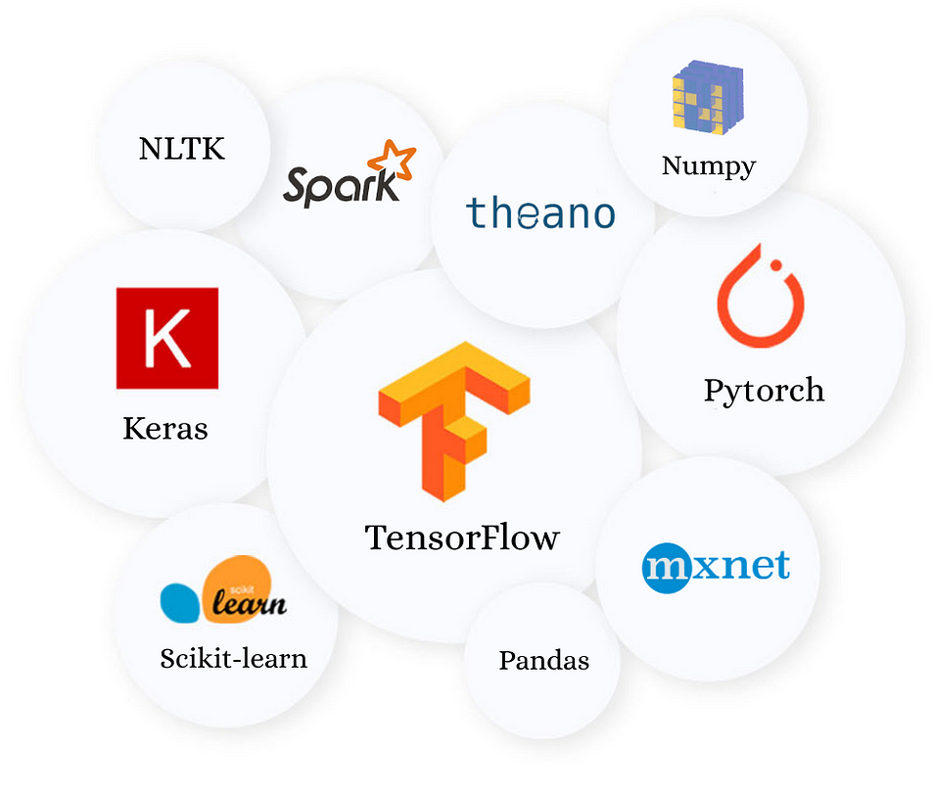
Why PyTorch?
There are a few reason you might prefer PyTorch to other deep learning libraries:
It is pythonic- concise, close to Python conventions
Unlike other libraries like TensorFlow, where you have to first define an entire computational graph before you can run your model, PyTorch allows you to define your graph dynamically.
PyTorch is also great for deep learning research and provides maximum flexibility and speed.
Autograd- automatic differentiation, more in later modules
Similar to NumPy, another common-used library in Python for data processing
Notes:
https://sites.cc.gatech.edu/classes/AY2021/cs7650_fall/slides/Introduction_to_PyTorch.pdf
https://heartbeat.comet.ml/introduction-to-pytorch-for-deep-learning-5b437cea90ac

Slide 20
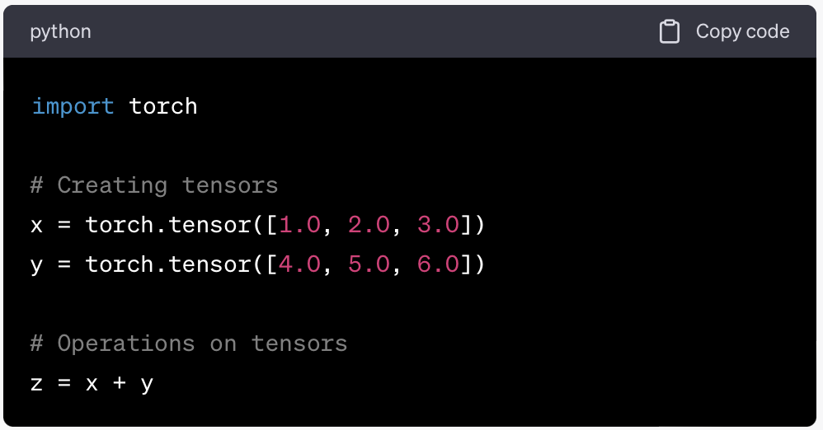
Tensors and Computation Graph
PyTorch revolves around tensors, similar to NumPy arrays but optimized for deep learning.
Computation graph in PyTorch is dynamic, allowing for dynamic network architectures and operations.
Notes:
Our original data is the dataset collected by our lab using 24h recall.
The data was collected in batch and there are some duplicated records in the first several batches.

Slide 21
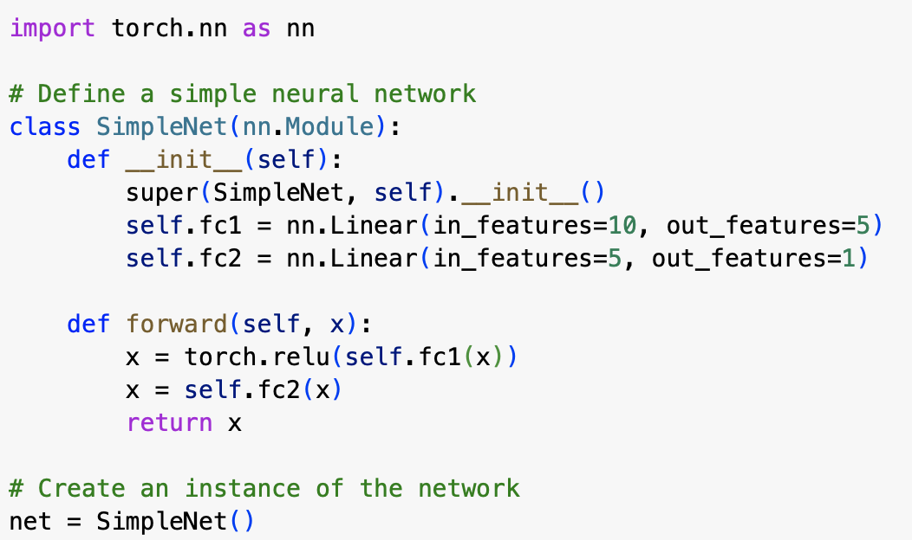
Building Neural Networks
PyTorch's torch.nn module facilitates building and training neural networks.
Define network architecture using classes and layers from the module.
Easily customize forward propagation and loss functions.
Notes:
Our original data is the dataset collected by our lab using 24h recall.
The data was collected in batch and there are some duplicated records in the first several batches.

Slide 22
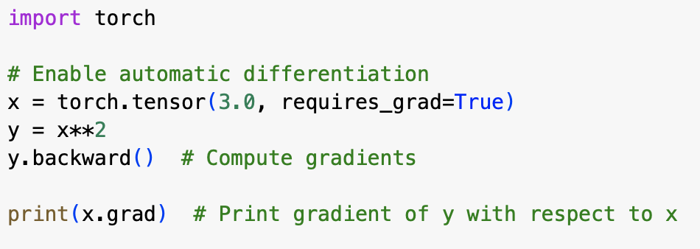
Autograd and Differentiation
PyTorch's automatic differentiation (autograd) tracks operations on tensors.
Gradients can be automatically calculated for backpropagation during optimization.
Notes:
Our original data is the dataset collected by our lab using 24h recall.
The data was collected in batch and there are some duplicated records in the first several batches.

Slide 23
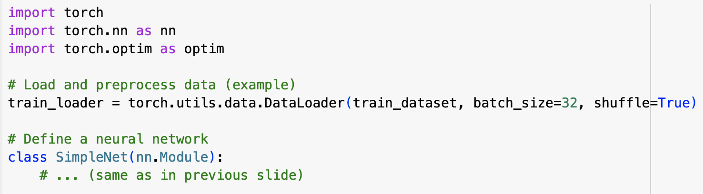
Training a Model
Steps to train a model in PyTorch:
Load and preprocess data.
Define the neural network architecture.
Choose a loss function and optimizer.
Iterate over data, perform forward and backward passes, and update weights.
Notes:
Our original data is the dataset collected by our lab using 24h recall.
The data was collected in batch and there are some duplicated records in the first several batches.

Slide 24
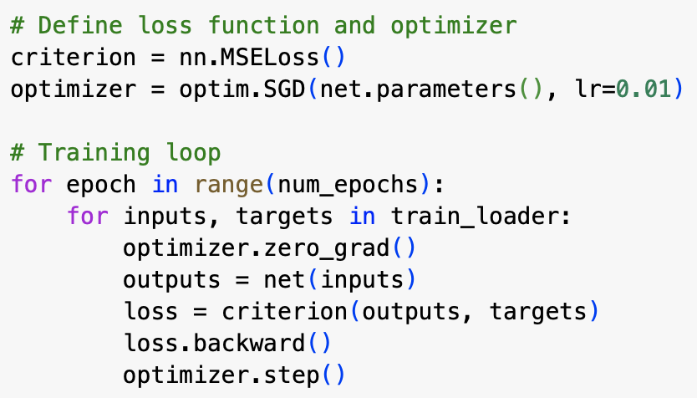
Training a Model (Continued)
Notes:
Our original data is the dataset collected by our lab using 24h recall.
The data was collected in batch and there are some duplicated records in the first several batches.

Slide 25
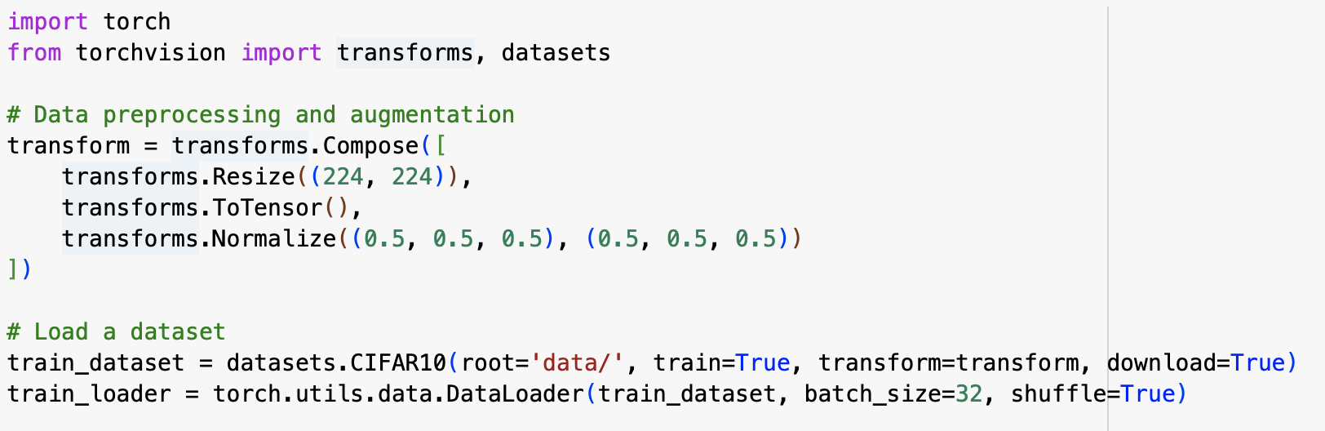
Loading and Preprocessing Data
PyTorch's torch.utils.data and torchvision modules assist in loading and preprocessing datasets.
Data loaders handle batching, shuffling, and parallel loading for efficient training.
Notes:
Our original data is the dataset collected by our lab using 24h recall.
The data was collected in batch and there are some duplicated records in the first several batches.

Slide 26
Content
1 Introduction to Deep Learning
2 Introduction to PyTorch
3 Introduction to UNC Research Computing Resources
4 Introduction to Basic Algorithm
Notes:
My presentation will include the following points.

Slide 27
UNC Longleaf
Before begin:
Establish a VPN connection with UNC.
[For VPN instructions, search https://help.unc.edu for VPN.]
If you do not have longleaf account yet, request it now:
https://help.rc.unc.edu/request-a-cluster-account/
If there's time, download…
and install the ssh app longleaf prefers:
https://help.rc.unc.edu/getting-logged-on/
These Using Longleaf course slides:
https://its.unc.edu/research-computing/research-computing-presentations/

Slide 28
UNC ITS Computing Resources
Provides "computing infrastructure as well as other technology tools and capabilities to support the research needs of University faculty and staff"
Resource examples:
VCL: Virtual Computing Lab
Longleaf Cluster (today)
Dogwood Cluster
DGX Cluster
Secure Research Workstation
Access to Xsede Campus Champions program
List grows all the time...including some cloud computing.
Need help?
https://help.rc.unc.edu
research@unc.edu answered during business hours, M-F

Slide 29
Before Computing on Longleaf
Properly
Connect to Longleaf (log on)
Move your project’s data & programs to/from storage areas in longleaf
Pick and manage your software “modules”
Schedule jobs to run on longleaf’s compute nodes
Monitor the status of jobs, their output and results
Navigate a Linux operating system (not in this course)
THEN you can have fun doing your project on longleaf.

Slide 30
Access Longleaf
Two ways to connect:
Via an ssh connection: ssh –X <onyen>@longleaf.unc.edu
Requires an ssh program on your computer, and not the one your computer came with.
If connecting from off-campus, your computer is required to establish a VPN connection to UNC before connecting to longleaf. Search help.unc.edu for VPN.
Via Open OnDemand (OOD): https://ondemand.rc.unc.edu
***New in 2020***
Yes any browser will do! (But not your cell phone)
Limited access to longleaf, but enough for many users.
DUO authentication required.
Read More: https://help.rc.unc.edu/getting-logged-on/

Slide 31
Content
1 Introduction to Deep Learning
2 Introduction to PyTorch
3 Introduction to UNC Research Computing Resources
4 Introduction to Basic Algorithm
Notes:
My presentation will include the following points.

Slide 32
Case Study: Logistic Regression in PyTorch
Identifying handwritten digits using Logistic Regression in PyTorch.ipynb

Slide 33
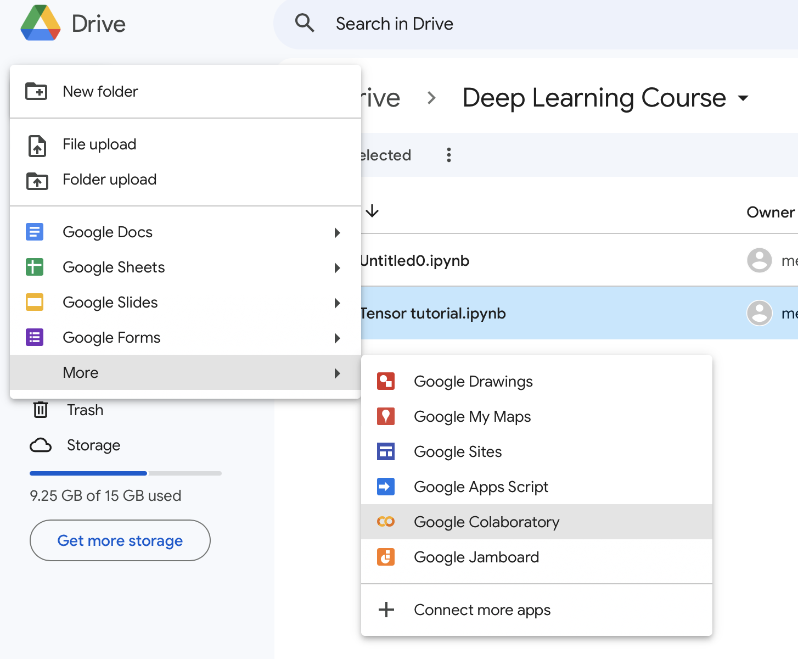
Case Study: Logistic Regression in PyTorch
Running example code in Google Colab – a good start for beginners
First step: How to access to Google Colab?
1. Log into Google Drive.
2. In Google Drive, create a new Google Colab notebook.
3. Start coding then.

